Slide 1
Investment Case Study

Slide 2
Executive Summary
Business Requirement
Data Set
Data Analysis
Outcome
Go with Industry trend in investment – Other Investors are Investing
Investment range of $ 5 M to $ 15 M per round of Investment
English Speaking
Countries
Rounds2.csv – This is a master file with contain information about funding type, funding date, funding amount and company org link
Companies.txt – It is a delimited file with information about company name, category, country, region and founded at is present along with unique permalink
Mapping.csv – This file has mapping of category with main sector. Data of category is dirty and need cleaning
Investment Analysis – best sector to invest
Country Analysis – Top 3 English speaking countries
Sector Analysis – Best sectors in those countries to investment in
Company Analysis – Best companies to invest with
Tools:
R
Tableau
Excel
Technique:
CRISP – DM Framework
Slicing, Dicing, Roll up, Drill Down, Filtering, Aggregation, Decision Tree
“Venture” is most followed investment type with 59% investments happen in this type. Average investment in this is ~ $ 11 M
USA, GBR, IND are top 3
English Speaking destination
“Others” is the most preferred sector followed by “Social, Finance, Analytics and Advertisement”
Virtustream, Electric Cloud, FirstCry.com are most recommended companies followed by SST Inc., Celltick Technologies and Manthan Systems

Slide 3







Framework and Technique used for Analysis
We used CRISP – DM Methodology to breakdown the given dataset. It was done using various techniques
Business Understanding
Business Objective and Business Strategy
Investment as per industry trend
Range $ 5 - $ 15 Million
English Speaking Countries
Correlation of data provided in Companies, Round2 and Mapping file.
Ref: List of English Speaking Countries
Covert mapping to long format
Identify the main sectors in round2
Cleaning the dirty data in mapping file
Data Understanding
Star Schema
Data Preparation
Data Cleaning, Data Separation,
Merging
Modeling
This was not applicable as no predictive
analysis is done
No Data Modeling technique is used
Slicing, Dicing, Rollup, Drill Down
Filtering, Aggregation, & Decision Tree
Subsets or filters
Group the dimension attributes
Aggregate on fact / measure attributes
Evaluation
Deployment
Tableau For Data Visualization
Publish Analysis and Recommendations

Slide 4
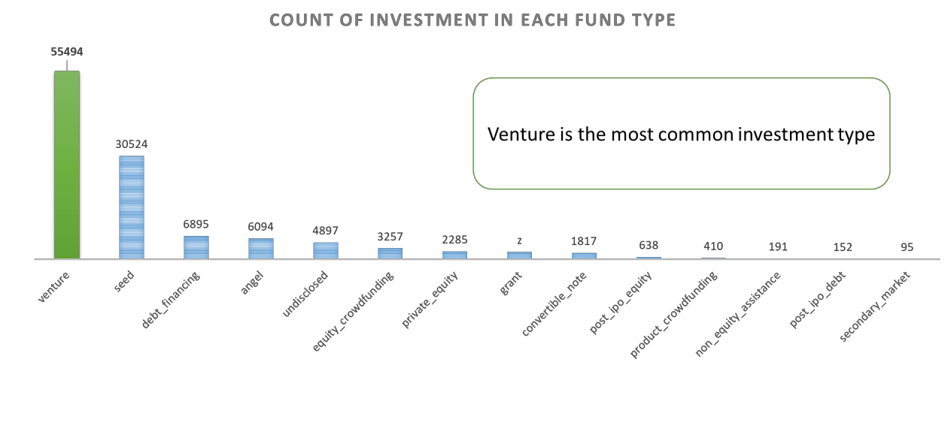
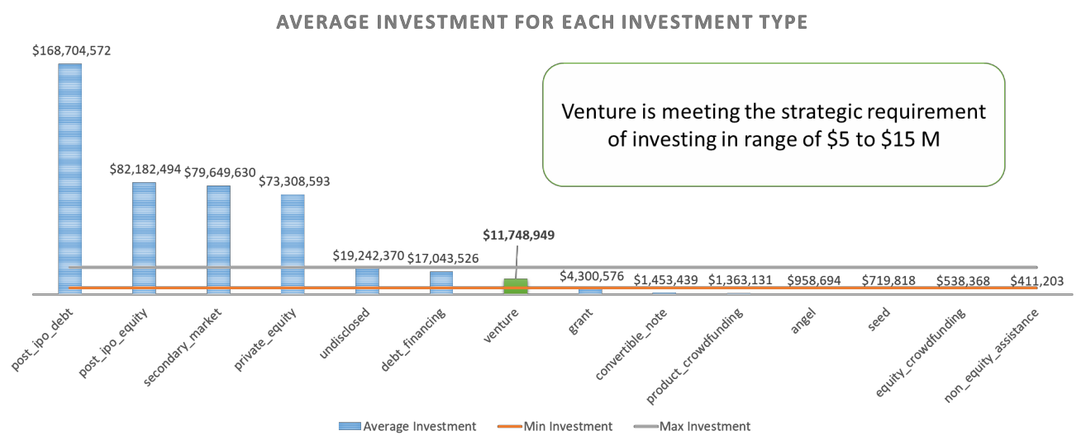
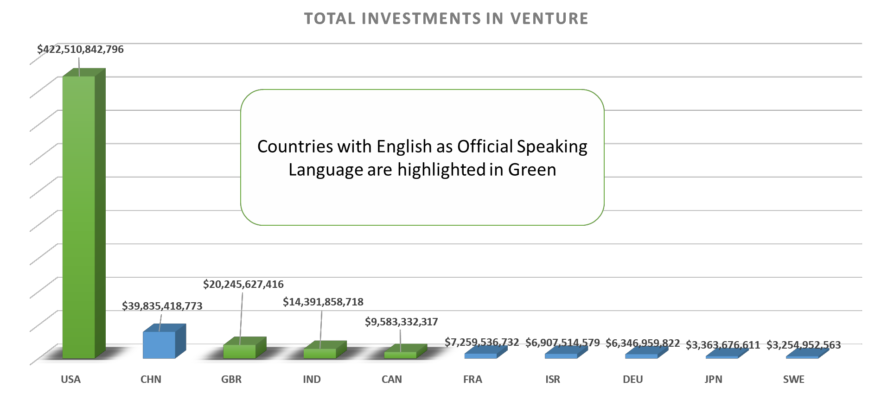
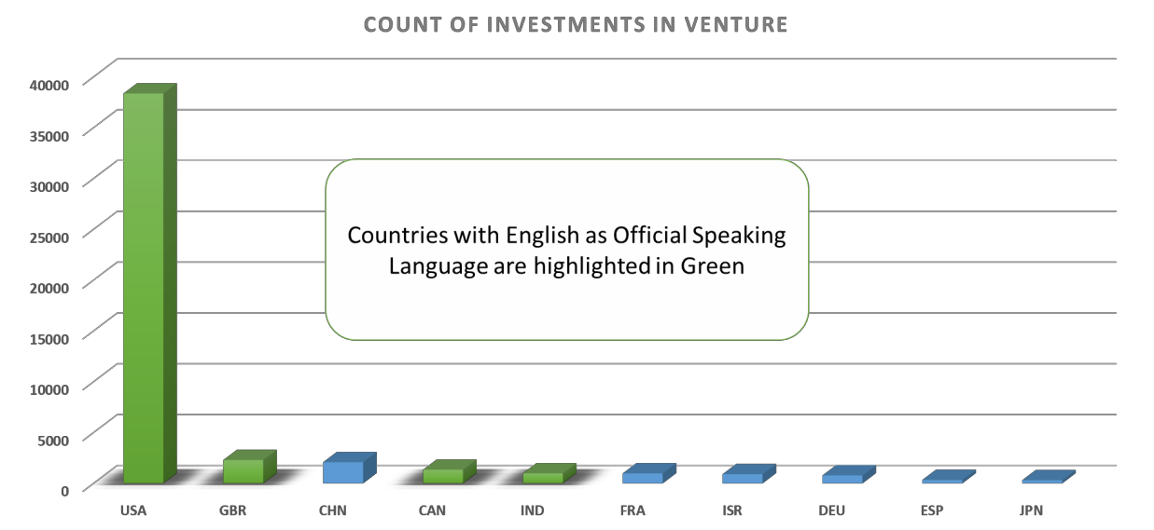
Analysis to identify best investment Type and Country
Slicing technique and aggregate function is used to identify the recommended countries for Spark Funds

Slide 5
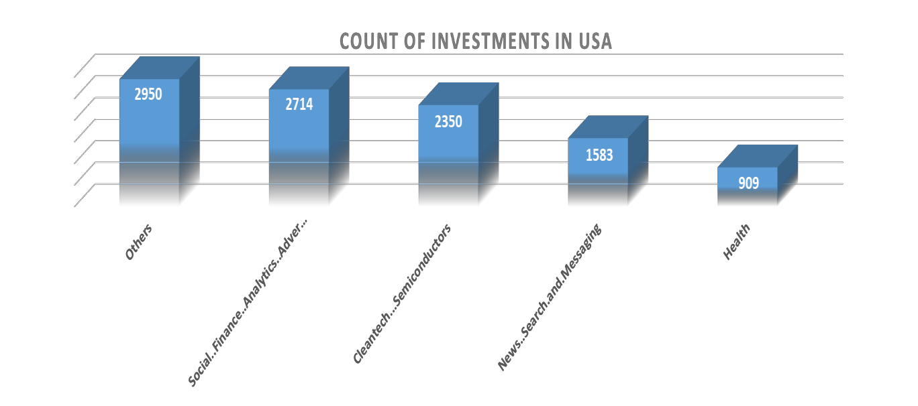
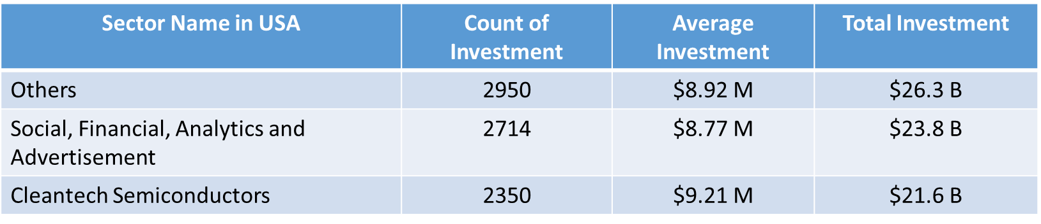
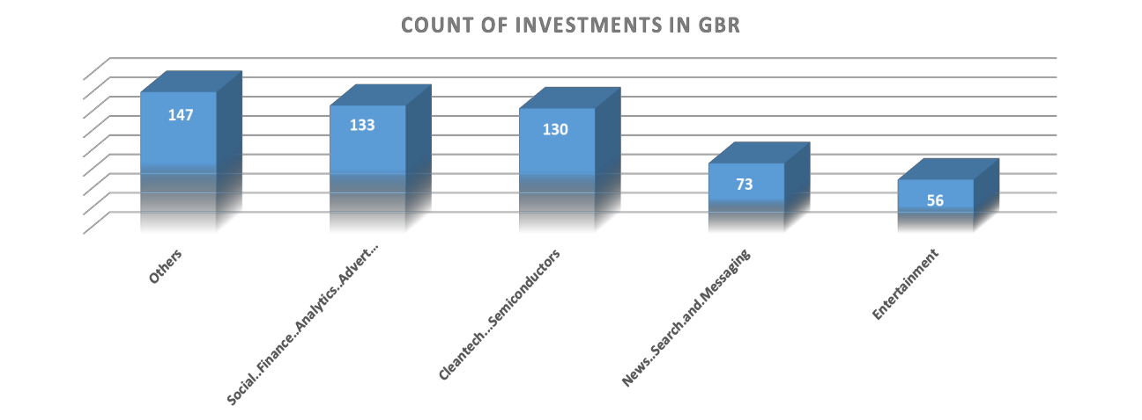
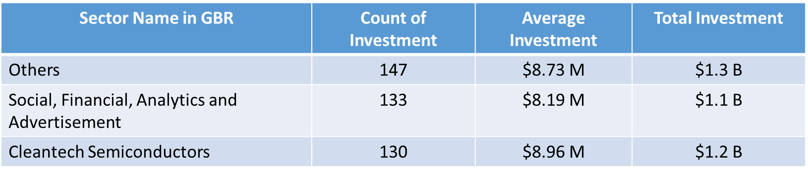
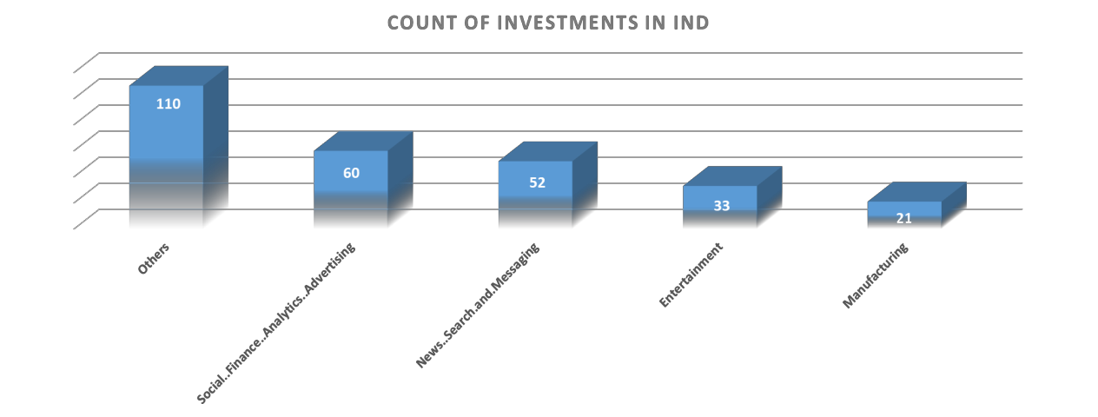
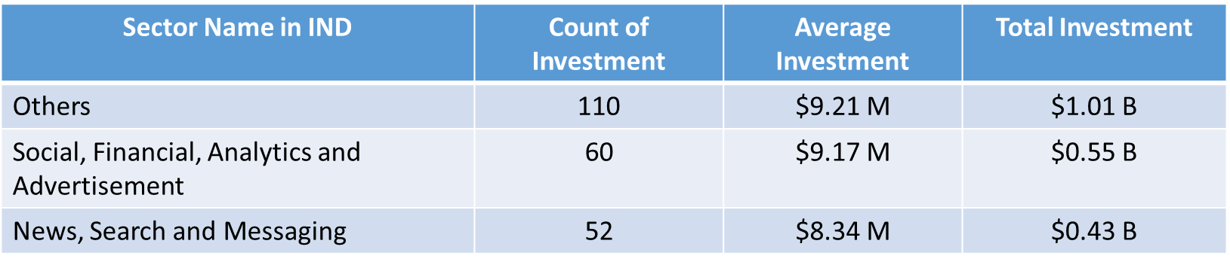
Analysis to identify best sectors in recommended countries for Venture Investment

Slide 6
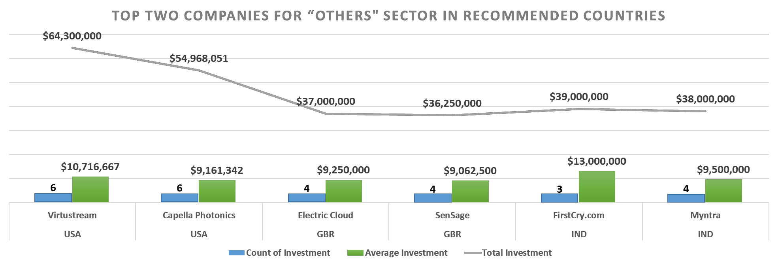
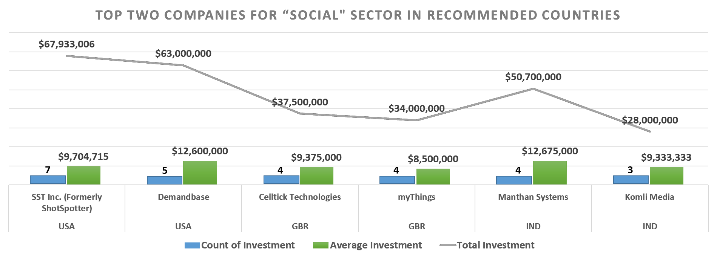
Analysis to identify best companies in recommended sectors and countries for Venture Investment
“Others” is the Most recommended Sector for
Investment Type Venture.
These are identified as top two companies in each recommended region for this sector
“Social, Finance, Analytics,
Advertisement” is the second most recommended Sector for Investment Type Venture.
These are identified as top two companies in each recommended region for this sector

Slide 7
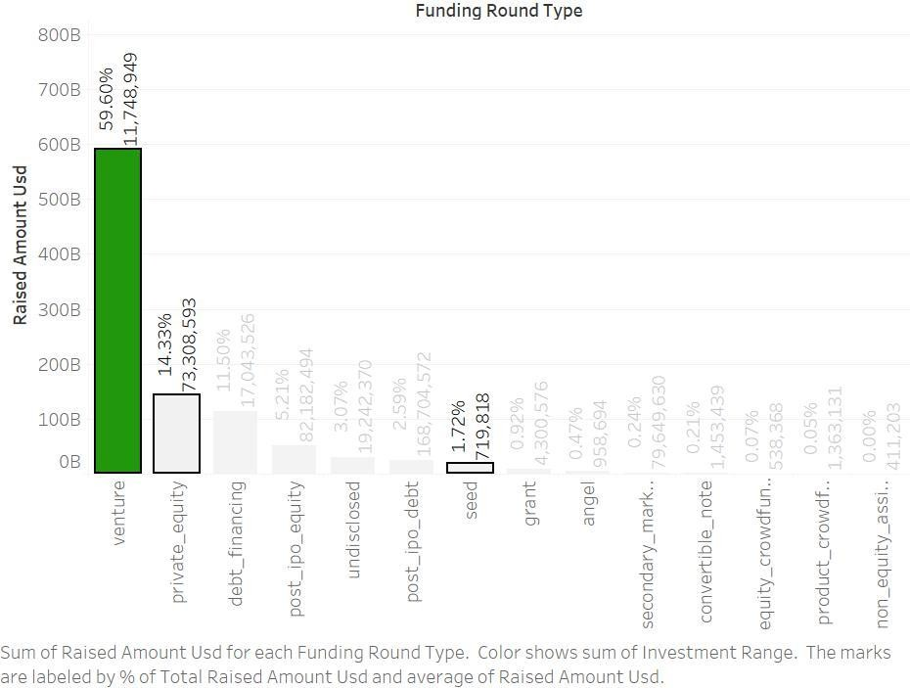
Plot depicting fraction of total investment along with value of average investment for each investment type

Slide 8
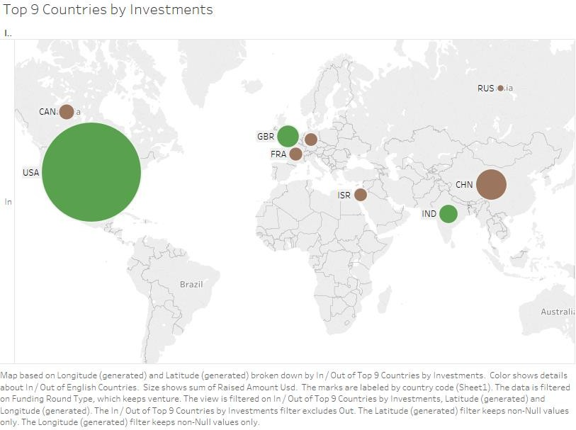
Plot showing top 9 countries based on total investment for Venture

Slide 9
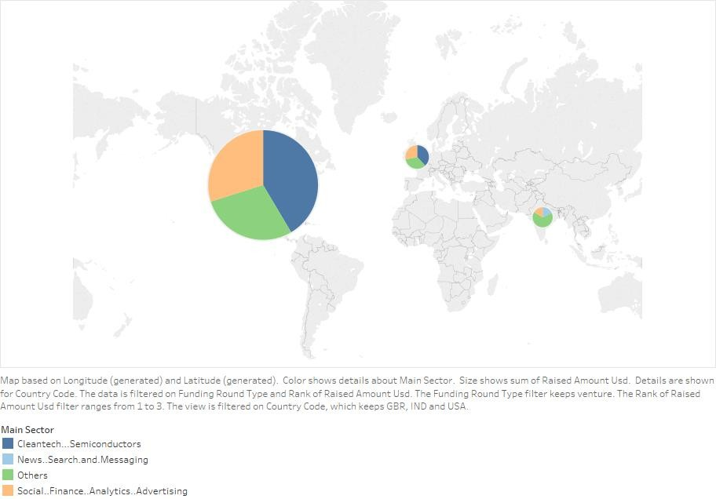
Plot showing top sectors in recommended countries based on count of investment for Venture

Slide 10
Recommendations and Assumptions
Average Values of Investments for Each of these Funding Types
1 | Average funding amount of venture type | $ 11,748,949.00
2 | Average funding amount of angel type | $ 958,694.50
3 | Average funding amount of seed type | $ 719,818.00
4 | Average funding amount of private equity type | $ 73,308,593.00
5 | Considering that Spark Funds wants to invest between 5 to 15 million USD per investment round, which investment type is the most suitable. | Venture
Assumptions
All blank cells for country code, category, main sectors, investment type and amount invested were not considered in this analysis. Providing this missing data will help us to analyze and provide more appropriate status and analysis
Mapping file was cleaned to have more accurate correlation of sectors with categories mentioned in companies.txt file
Provided PDF was used as reference and as no common field was provided to map country with provided country code, assumption is made to provide details about English speaking countries. However, if permitted, we can download the information from external sources to have better integration and firm analysis based on given country codes
Analysing the Top 3 English-Speaking Countries
1 | Top English speaking country | USA
2 | Second English speaking country | GBP
3 | Third English speaking country | IND
Sector-wise Investment Analysis
Sl.no | Analysis Category | USA | GBR | IND
1 | Total number of Investments (count) | 12150 | 628 | 330
2 | Total amount of investment (USD) | $ 108,531,347,515.00 | $ 5,436,843,539.00 | $ 2,976,543,602.00
3 | Top Sector name (no. of investment-wise) | Others | Others | Others
4 | Second Sector name (no. of investment-wise) | Social, Finance, Analytics, Advertising | Social, Finance, Analytics, Advertising | Social, Finance, Analytics, Advertising
5 | Third Sector name (no. of investment-wise) | Cleantech / Semiconductors | Cleantech / Semiconductors | News, Search and Messaging
6 | Number of investments in top sector (3) | 2950 | 147 | 110
7 | Number of investments in second sector (4) | 2714 | 133 | 60
8 | Number of investments in third sector (5) | 2350 | 130 | 52
9 | For point 3 (top sector count-wise), which company received the highest investment? | Virtustream | Electric Cloud | FirstCry.com
10 | For point 4 (second best sector count-wise), which company received the highest investment? | SST Inc. (Formerly ShotSpotter) | Celltick Technologies | Manthan Systems

